Slide 1
Septic arthritis
Mustafa Al-Badran
CABM FIBMS

Slide 2
The most rapid and destructive joint disease
The incidence
2–10 per 100 000 in the general population
30–70 per 100 000 in population with pre-existing joint disease or joint replacement
Mortality of about 10%

Slide 3
Pathogenesis
Septic arthritis usually occurs as a result of
Hematogenous spread from infections of the skin or any other focus of infection
Infection from direct puncture wounds or secondary to joint aspiration is uncommon

Slide 4
Risk factors
Increasing age
Pre-existing joint disease (Principally RA)
Diabetes mellitus
Immunosuppression (by drugs or disease)
Intravenous drug misuse

Slide 5
In RA, the skin is a frequent portal of entry because of
Maceration of skin between the toes due to joint deformity
Difficulties with foot hygiene caused by hand deformity

Slide 6
Cellulitis near the knee (from a puncture wound) is at risk of spreading into the join

Slide 7
Clinical features
The usual presentation is with acute or subacute monoarthritis and fever
The joint is
Swollen
Hot
Red
Pain at rest and on movement

Slide 8
Types Of Organisms
Staphylococcus aureus (Most common in adults)
Gram-negative bacilli or group B, C and G streptococci (elderly and intravenous drug users)
A streptococci, Pneumococci, meningococci and Haemophilus influenzae (Less common)

Slide 9
Gonococcal Septic arthritis
More frequent in young, sexually active adults
Disseminated gonococcal infection occurs in up to 3% of patients with untreated gonorrhoeae
Presentation with
Low-grade fever
Migratory arthralgia
Tenosynovitis
Painful pustular skin lesions

Slide 10
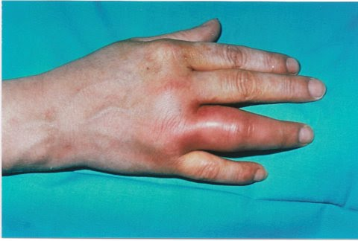

Slide 11
Investigations
Joint aspiration (Pivotal)
Synovial fluid should be sent for Gram stain and culture
Gram stain is positive in only 50%
Cultures are positive in around 90%
Synovial fluid culture is positive in only 30% of gonococcal infections but genital tract culture positive in 70–90% of cases
Blood cultures

Slide 12
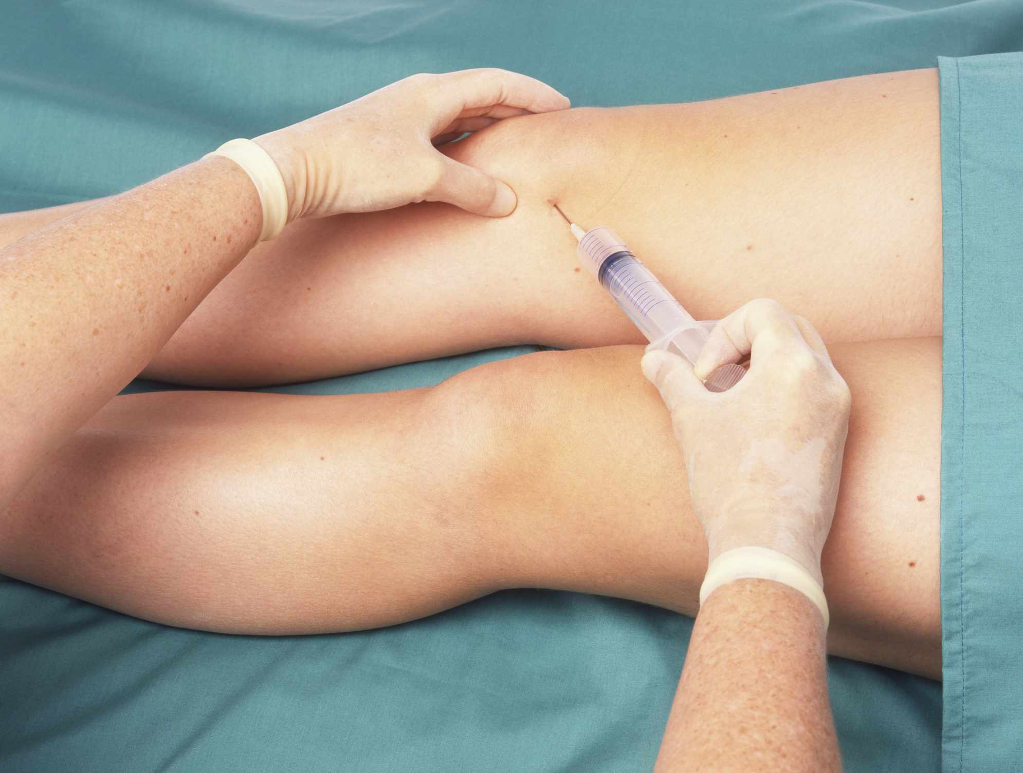
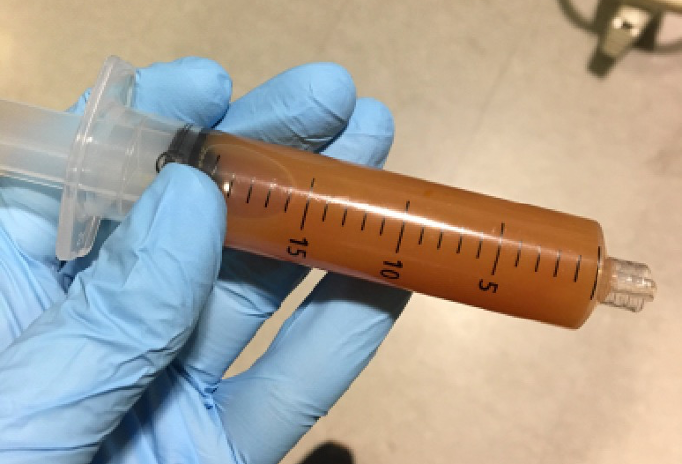
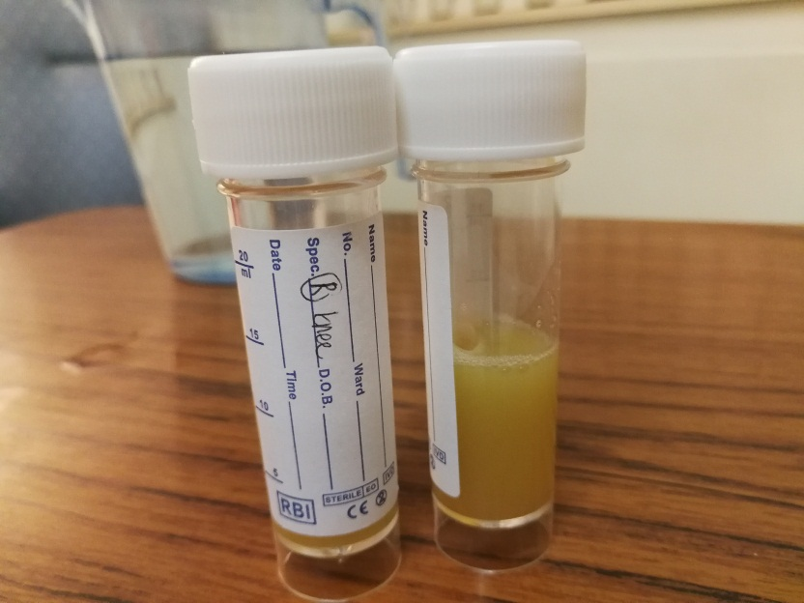

Slide 13
Absent in
Elderly
Immunocompromised
Early in the disease course
Leucocytosis
Raised ESR and CRP
Serial measurements of CRP and ESR are useful in following the response to treatment
Notes:
* these features may be.

Slide 14
Emergency Management of Suspected Septic Arthritis
Admit patient to hospital
Perform urgent investigations
Aspirate joint: Send synovial fluid for Gram stain and culture
Send blood for culture, routine biochemistry and haematology, including ESR and CRP
Consider sending other samples (sputum, urine, wound swab) for culture, depending on patient history

Slide 15
Commence intravenous antibiotic
Flucloxacillin (2 g 4 times daily)
if penicillin-allergic:
Clindamycin (450–600 mg 4 times daily in younger patients)
Intravenous vancomycin (1 g twice daily if age > 65 years)
If high risk of Gram-negative sepsis (recurrent urinary tract infection):
Intravenous gentamicin (5 mg/kg once daily) or vancomycin (750–1000 mg twice daily

Slide 16
Relieve pain
Oral and/or intravenous analgesics
Consider local ice-packs
Aspirate joint
Perform serial needle aspiration to dryness (1–3 times daily or as required)
Consider arthroscopic drainage if needle aspiration difficult
Arrange physiotherapy
Early regular passive movement, progressing to active movements once pain controlled and effusion not re-accumulating

Slide 17
You are the best student ever

